Slide 2
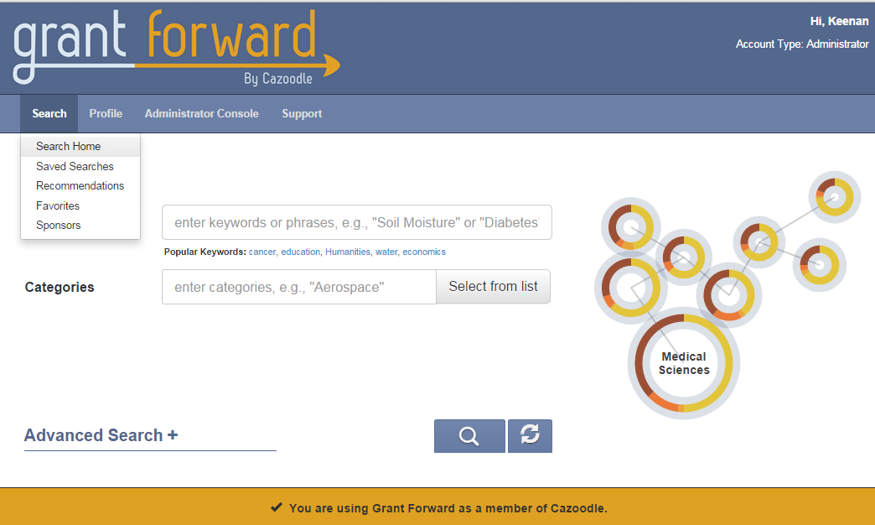
Select “Search Home” from the drop down Search menu.
Select “Search Home” from the drop down menu

Slide 3
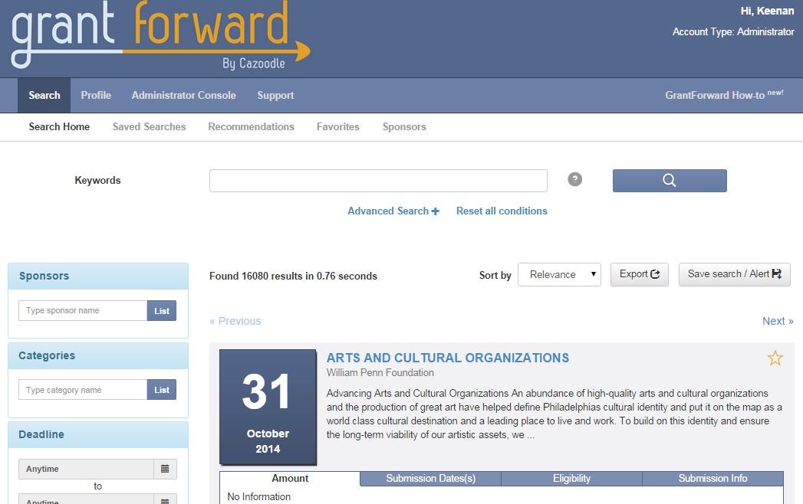
Enter search words into keyword box.
Or click “Advanced Search” for more specific results.

Slide 4
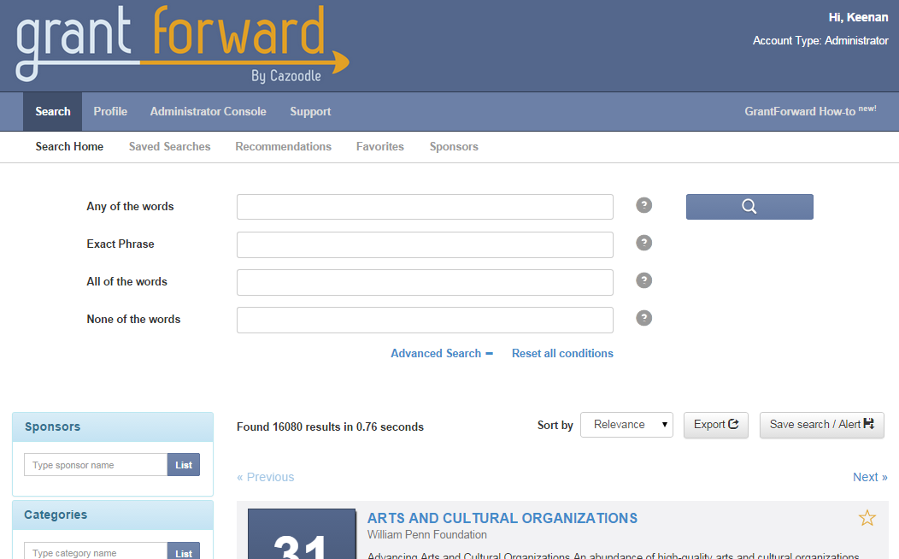
Enter specifics into these boxes for more exact results.

Slide 5
advanced search
ANY OF THE WORDS: Same as a Keyword Search
EXACT PHRASE: Search results must include this exact phrase (order of the words matter)
ALL OF THE WORDS: Only results with all of the words will be displayed (order of the words does not matter)
NONE OF THE WORDS: Excludes any results that include the keywords entered

Slide 6
Favorite funding opportunities by clicking the star.
The Amount tab states the value of the funding opportunity.

Slide 7
The Submission Date tab shows the deadline for the funding opportunity.

Slide 8
The Eligibility tab shows who is able to apply
for the funding opportunity.

Slide 9
Submission Info gives additional information about the funding opportunity.

Slide 10
Click the opportunity’s title to view additional information.

Slide 11
Click here to go to the webpage with the application for the funding opportunity.
“Opportunity Source” takes you to the original homepage of the funding opportunity.

Slide 12
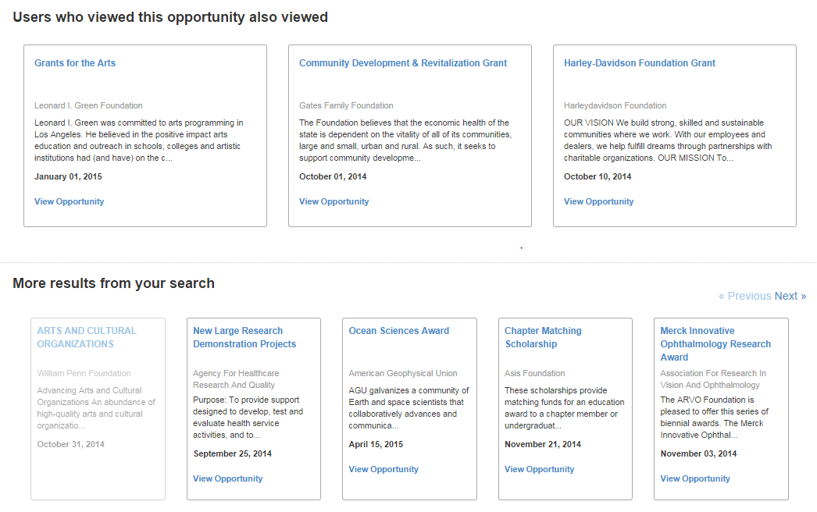
At the bottom of the page you can see what other users interested in that funding opportunity viewed, along with additional results from your search.

